Slide 1
Face Recognition Using OpenCV with python

Slide 2
Table Of Contents
Introduction
Feature Extraction
Conclusion
Project Objective
Viola Jones Algorithm
Face Detection
OpenCV
Face Recognition
Output

Slide 3
Introduction
Face detection is an image recognition task in which we try to detect human faces.
Face detection and identification have evolved from a niche to a major area of computer vision research.
There are a variety of face detection algorithms available, but the Viola-Jones Algorithm is one of the oldest and most widely used, and we will utilize it in this project.
Face Recognition is the technique in which the identity of a human being could be identified using their respective individual face.

Slide 4
Project Objective
Our project aims to enable human-machine interaction more conveniently when user identification is required using facial detection and recognition.
A computer can identify and recognize a person's face with the help of a standard web camera.
For Recognition of faces the image is cropped and removed to make the person's face easier to recognize wherever a photograph is searched for a face.
Face Detection using OpenCV is built-in to this framework, and it works in 90-95 percent of clear images of persons looking straight forward at the camera.

Slide 5
Face Detection
Face detection is a technique where we detect human faces in an image or a live webcam feed.
There may be minor changes in human faces, but it is fair to argue that some features are shared by all human faces.
One of the application of face detection, when you take a picture of your friends, your digital camera's face detection technology determines where the faces are, changes the focus accordingly.
Supporting mobile device engagement is another good use of facial detection/tracking.

Slide 6
Face Recognition
A facial recognition system is a technology capable of matching a human face from a digital image or video frame against a database of faces.
Facial recognition systems attempt to identify a human face, which is three dimensional and changes in appearance with lighting and facial recognition, based on its two dimensional image.

Slide 7
Feature Extraction
We extract features from the image from the face that has been clipped or cropped out.
Face Embeddings will be used to extract the features from the face in this case.
A neural network takes an image of a person’s face as input and produces a vector that represents the face ‘s most important attributes.
This vector is known as embedding in machine learning, but it is known as face embedding.

Slide 8
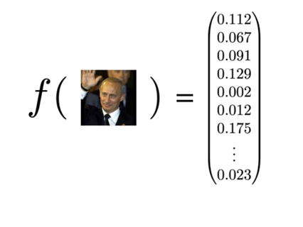
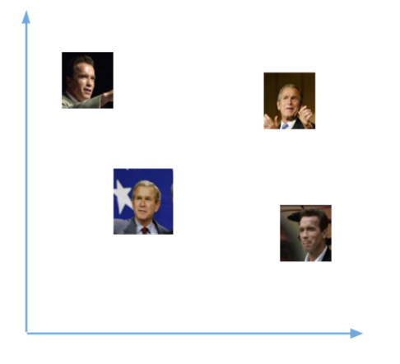
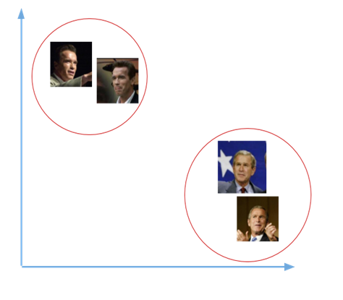
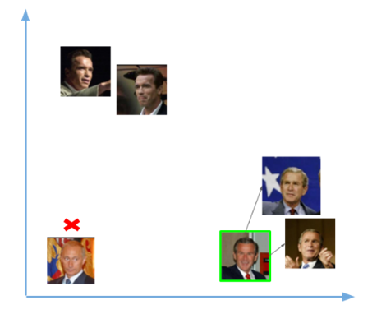
Figure 1
Figure 2
Figure 3
Figure 4

Slide 9
Viola Jones Algorithm
The Viola-Jones object detection framework was introduced by Paul Viola and Michael Jones in 2001 as an object detection framework.
It detects the position on the colored picture after detecting the face on the grayscale image.
It looks at many smaller subregions and tries to find a face searching for specific features in each subregion.
The Algorithm has four steps namely:
Selecting Haar-like features
Creating an integral image
Running AdaBoost training
Creating Classifier cascades

Slide 10
OpenCV (Open source computer vision library)
Computer vision is one of the most fascinating and difficult tasks in Artificial Intelligence.
Computer vision serves as a link between software and the visual world around us.
It enables software to comprehend and learn about the visualizations in the environment.
For instance: Color, shape, and size are determined based on this.
OpenCV is an open-source library. Various programming languages, such as Python, support it.
It works on most operating systems, including Windows, Linux, and macOS.

Slide 11

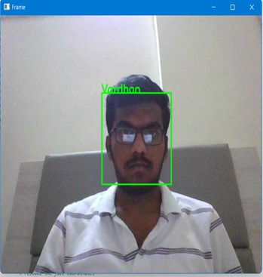

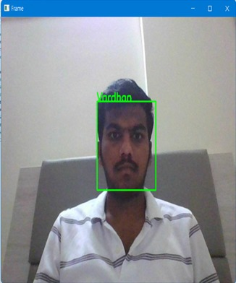
Output

Slide 12
Conclusion
The point to be noticed is that it is easy to recognize the images if humans performed the tests, but it is the computer that is doing it and it thinks in terms of pixels and numbers.
It is matching images by basically doing the equivalent of subtracting the testing image to see how far the test image and train image is similar.
Since the images are almost aligned perfectly, in many cases it actually means that using small and low-resolution images (thumbnail images) can give a better result of recognition than a large and high-resolution image.

Slide 13
Thank you.
Mentor : - Dr. Radha Guha
Team : -
G. Balaji - AP19110010517
N. Praneeth Babu - AP19110010383
M. Rohan Bhaskar - AP19110010466
B. Vardhan Kumar Reddy - AP19110010493

